Slide 1
Building a Website using Object-Orientated PHP
Project Intro

Slide 2
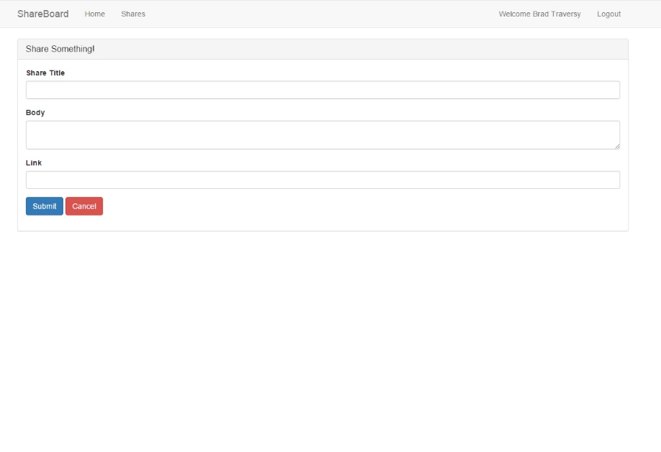
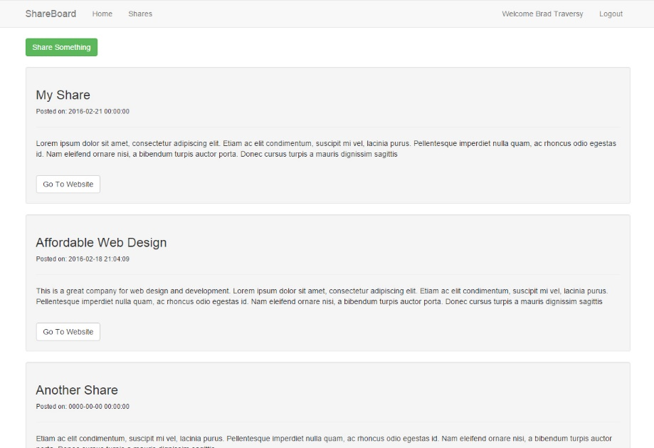
Project Description
We will build an application that allows users to register, login and create “shares” which are mini posts with a title, body and link to some other resource such as an article or blog post
We will build our own custom MVC framework to create the application

Slide 3
Topics Covered
MVC – We will build our own mini-framework
User Login & Registration
Working with Sessions
Fetch & insert data into MySQL through our application

Slide 4
Part 1 - Section Overview
Section Intro
Folder Structure & Bootstrap Class
Creating Controllers
Creating Models
Creating Views

Slide 5
Part 2 - Section Overview
Adding Shares
User Registration
User Login & Sessions
Message Class & Access Control

Slide 6


